Slide 1
Classification and Prediction
Classification by Neural Networks

Slide 2
Classification and Prediction
Basic Concepts
Issues Regarding Classification and Prediction
Decision Tree
Bayesian Classification
Neural Networks
Associative classification
Classification Accuracy

Slide 3
Classification: A Mathematical Mapping
Classification分类:
  predicts categorical class labels预测分类标签
E.g., Personal homepage classification例如，个人主页分类
  xi = (x₁, x₂, x₃, …), y_{i} = +1 or -1
  x₁ : “homepage”的数量
  x₂ : “welcome”的数量
Mathematically数学的
  x ∈ X = ℜ^{n}, y ∈ Y = {+1,-1}
  我们想要一个函数f: X -> Y

Slide 4
Linear Classification
Binary Classification problem二进制分类问题
The data above the blue line belongs to class ‘x’蓝线上的数据属于‘x’类
The data below blue line belongs to class ‘o’蓝线下的数据属于‘o’类
Examples例子:
SVM, Perceptron感知机,
x
x
x
x
x
x
x
x
o
x
o
x
o
o
o
o
o
o
o
o
o
o
o

Slide 5
Discriminative Classifiers
Advantages优点
  prediction accuracy is generally high 预测精度总体上高
    (as compared to Bayesian methods – in genera于贝叶斯方法相比-—大体上l)
  当训练例子有错误时，能稳健工作
  fast evaluation of the learned target function学习的目标函数的快速评估
    (Bayesian networks are normally slow贝叶斯网络通常是缓慢的)
Criticism批评
  long training time长训练时间
  difficult to understand the learned function 学习函数难以理解(weights)
    (Bayesian networks can be used easily for pattern discovery贝叶斯网络可以用于模式发现)
  not easy to incorporate domain knowledge结合领域知识不容易
    (easy in the form of priors on the data or distributions数据或分布的先验形式很容易)

Slide 6
Neural Networks
Analogy to Biological Systems (Indeed a great example of a good learning system)类比生物系统（实际上是良好学习系统的一个很好的例子）
Massive Parallelism allowing for computational efficiency大规模并行处理允许计算效率
The first learning algorithm came in 1959 (Rosenblatt) who suggested that if a target output value is provided for a single neuron with fixed inputs, one can incrementally change weights to learn to produce these outputs using the perceptron learning rule第一个学习算法产生于1959年，布拉特建议，如果一个目标输出值被提供给一个有固定输入的单一神经元，那么可以逐步改变权重，以了解用感知学习规则产生这些输出

Slide 7
A Neuron (= a perceptron)
n维输入向量x通过内积映射到变量y和一个非线性函数映射
-
μ_{k}
x₀
w₀
x₁
w₁
∑
f
output y
x_{n}
w_{n}
Input
vector x
weight
vector w
weighted
sum
Activation
Function(赋活函数)

Slide 8
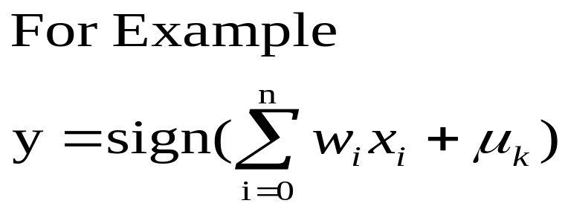
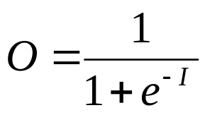
A Neuron (= a perceptron)
μ_{k} Bias
x₀
w₀
x₁
w₁
∑
f
output y
x_{n}
w_{n}
Input
vector x
weight
vector w
weighted
sum
Activation
function
Logistic or sigmoid

Slide 9
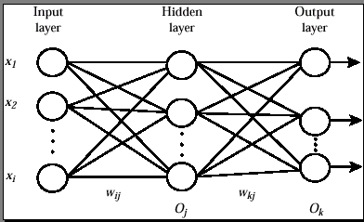
Multi layer Neural Network

Slide 10
Network Training
The ultimate objective of training 培训的最终目标
  obtain a set of weights that makes almost all the tuples in the training data classified correctly 获得使训练数据中几乎所有元组分类正确的权重的集合
Steps步骤
  Initialize weights with random values 用随机值初始化权重
  Feed the input tuples into the network one by one将输入元组一个一个注入网络
  For each unit对每一个单元
    Compute the net input to the unit as a linear combination of all the inputs to the unit
    Compute the output value using the activation function用激活函数计算输出值
    Compute the error计算错误
    Update the weights and the bias更新权重和偏置

Slide 11

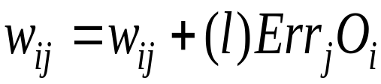

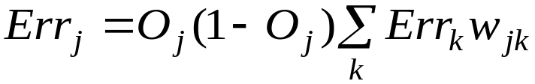
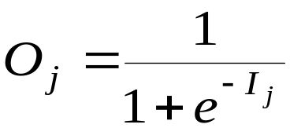
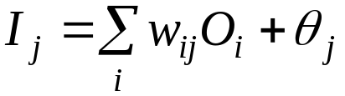
Back Propagation
输出向量
输出节点
K
隐藏节点
j
w_{ij}
输入节点
i
输入向量: x_{i}

Slide 12
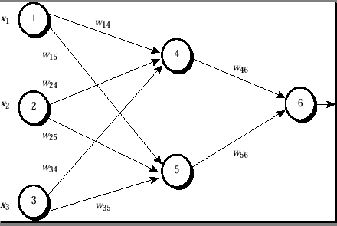
Back Propagation

Slide 13
One example (1)
Input: X={1,0,1}, output: 1
x1=1, x2=0, x3=1,
w14=0.2, w15=-0.3,
w24=0.4, w25=0.1,
w34=-0.5, w35=0.2,
w46=-0.3, w56=-0.2,
Bias: node 4:-0.4, node 5: 0.2, node 6: 0.1
Learning rate l=0.9

Slide 14
One example (2)
Node 4:
input :w14*x1+w24*x2+w34*x3+bias of node 4=1*0.2+0.4*0-0.5*1-0.4=-0.7
output:
O₄=0.332
The same: node 5: input: 0.1, output:0.525
Node 6:
input :w46*o4+w56*o5+bias of node 6=-0.3*0.332-0.2*0.525+0.1=-0.105
output:0.474

Slide 15
One example (3)
Node 6:
0.474*(1-0.474)*(1-0.474)=0.1311
Node 5:
0.525*(1-0.525)*0.1311*(-0.2)=-0.0065
Node 4:-0.0087

Slide 16
One example (4)
W46:
-0.3+(0.9)(0.1311)(0.332)=-0.261
Other Wij is the same with w46
Bias of node 6:
0.1+(0.9)*(0.1311)=0.218
Other bias is the same with node 6

Slide 17
Network Pruning and Rule Extraction
Network pruning网络修剪
  Fully connected network will be hard to articulate完全连接的网络将是很难连接
  N个输入节点，h个隐藏节点和m个输出节点，导致h(m+N)权重
  修剪:删除一些不会影响网络分类精度的连接
提取规则：用聚类评价训练网络取代单个激活值
  保持网络精度的离散激活值
  Enumerate the output from the discretized activation values to find rules between activation value and output从离散激活值枚举输出值，在激活值和输出中找到规则
  Find the relationship between the input and activation value 在输入和激活值之间找到关系
  Combine the above two to have rules relating the output to input结合上述二者找到联系输出和输入的规则

